Slide 1
String Manipulation
Warren Toomey,
Charles Severance
Notes:
1

Slide 2

Copyrights
Some of this slideset is © 2010 Charles Severance under a CC BY 3.0 license
His original slides are at
http://www-personal.umich.edu/~csev/books/py4inf/media/Py4Inf-06-Strings.ppt
Slides marked with the logo come from this slideset
Insert competency code
Notes:
1

Slide 3
Python Types
We have already seen three Python types:
Strings, ints (whole numbers) and floats (numbers with decimal points)
And functions to convert between them:
str(), int() and float()
Insert competency code
Notes:
1

Slide 4
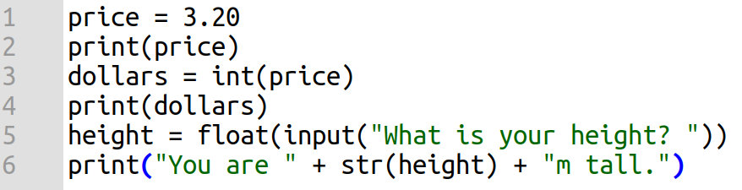
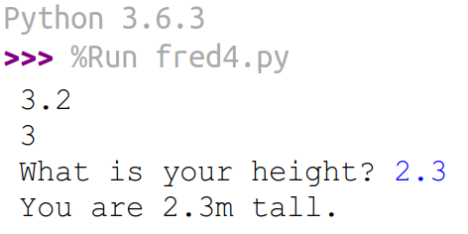
Example Conversion Between Types
Insert competency code
Notes:
Text
1

Slide 5
String Operations
Numbers and text are the most important data types: documents, money, scientific calculations etc.
We have seen the basic maths operators
But so far we haven’t seen many String operations
In Python, String operations are functions that transform an existing string and create a new String
Insert competency code
Notes:
1

Slide 6
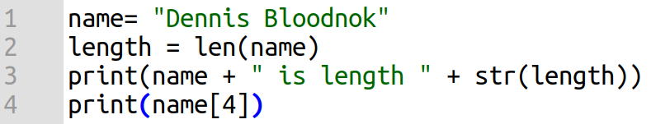
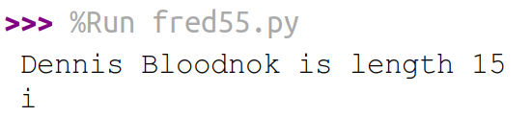
String Operations: Accessing Characters
We can treat a String as a list and access individual letters and get the String’s length
Question: why is name[4] ‘i’ and not ‘n’?
Insert competency code
Notes:
Text
1

Slide 7
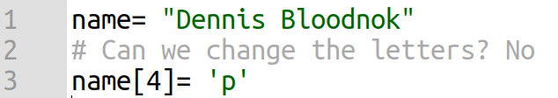
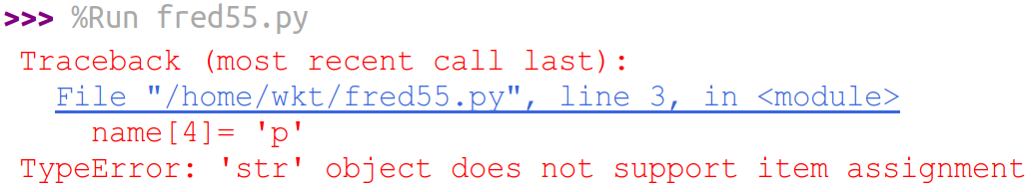
String Operations: Accessing Characters
Strings are immutable (can’t be changed)
Insert competency code
Notes:
Text
1

Slide 8
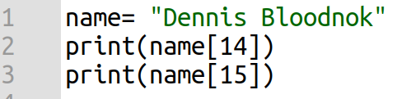
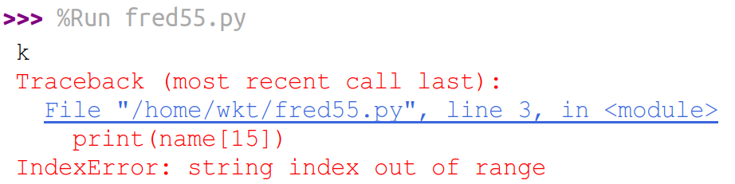
String Operations: Accessing Characters
We can’t access letters that are not there
Insert competency code
Notes:
Text
1

Slide 9
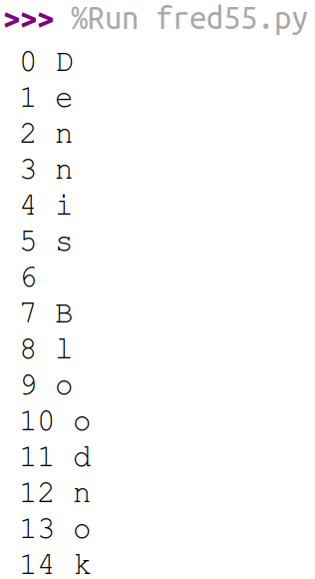
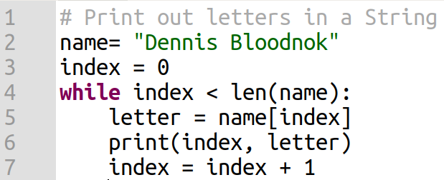
Looping Through a String’s Letters
Use a while loop and an index variable
Insert competency code
Notes:
Text
1

Slide 10
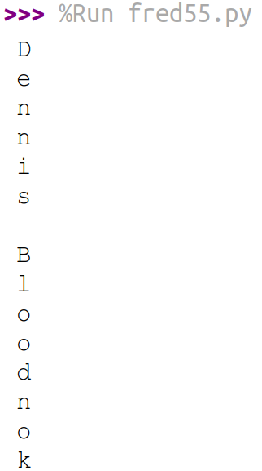
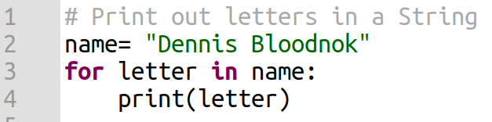
Looping Through a String’s Letters
A more elegant solution using a For loop
Insert competency code
Notes:
Text
1

Slide 11
Looping Through a String’s Letters
This is a simple loop that loops through each letter in a string and counts the number of times the loop encounters the 'a' character.
word = 'banana'
count = 0
for letter in word:
if (letter == 'a'):
count = count + 1
print count
Insert competency code
Notes:
1

Slide 12
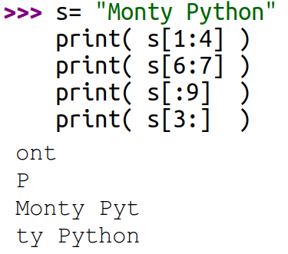
Slices of Strings
We can access subsections of Strings
These are called slices
Example:
M | o | n | t | y |  | P | y | t | h | o | n
0 | 1 | 2 | 3 | 4 | 5 | 6 | 7 | 8 | 9 | 10 | 11
Like range(), the end number is one after the real end value
No number before :, start at 0
No number after :, go to the end
Insert competency code
Notes:
Text
1

Slide 13
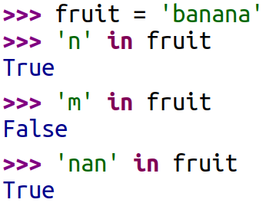
Using in as an Operator
The in keyword can also be used to check to see if one string is “in” another string
The in expression returns True or False and can be used in an if statement
Insert competency code
Notes:
Text
1

Slide 14
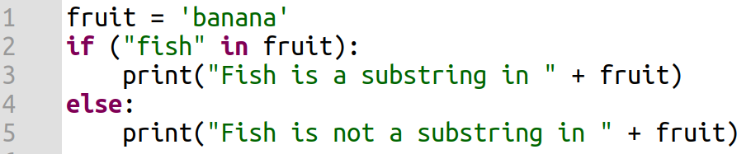

Using in as an Operator
The in expression returns True or False and can be used in an if statement
Insert competency code
Notes:
Text
1

Slide 15
String Comparisons
We can use the normal comparison operators to compare Strings
This is done in a lexicographic manner
== | Strings are equal
!= | Strings are not equal
< | First comes before second
> | First comes after second
<= | First comes before or is equal to second
>= | First comes after or is equal to second
Insert competency code
Notes:
1

Slide 16
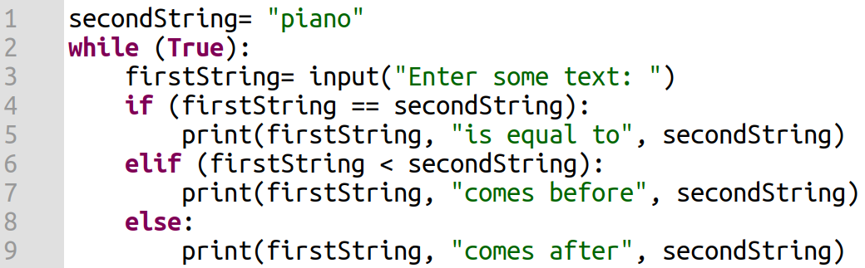
String Comparisons
Insert competency code
Notes:
Text
1

Slide 17
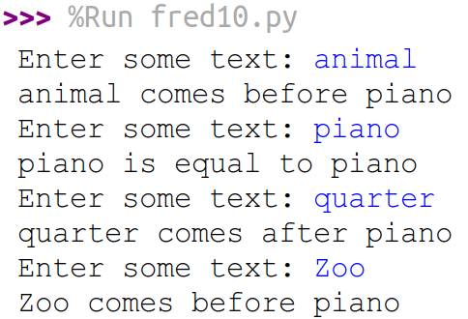
String Comparisons
Question: why does “Zoo” come before “piano”?
Insert competency code
Notes:
Text
1

Slide 18
Python’s String Library
Python has a number of string functions which are in the string library
These functions are already built into every string
We invoke them by appending the function to the string variable
These functions do not modify the original string
Instead they return a new string that has been altered
Insert competency code
Notes:
1

Slide 19
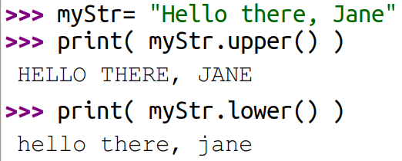
Python’s String Library: Examples
Insert competency code
Notes:
Text
1

Slide 20
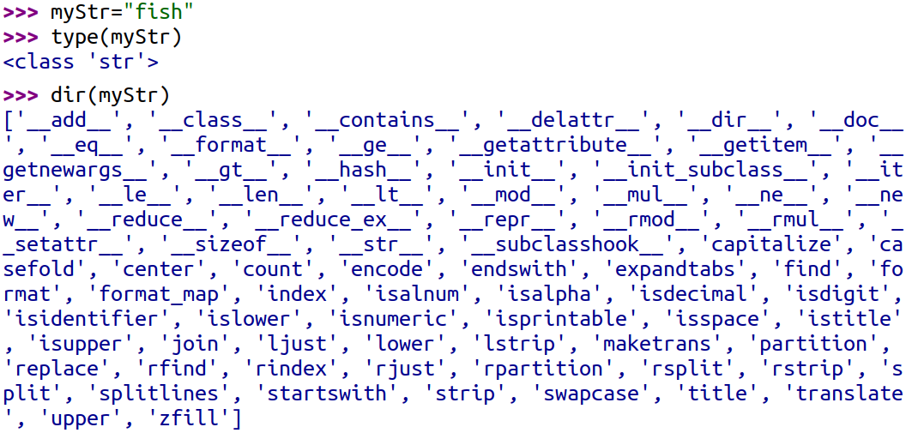
Python’s String Library: What’s Available?
Insert competency code
Notes:
Text
1

Slide 21
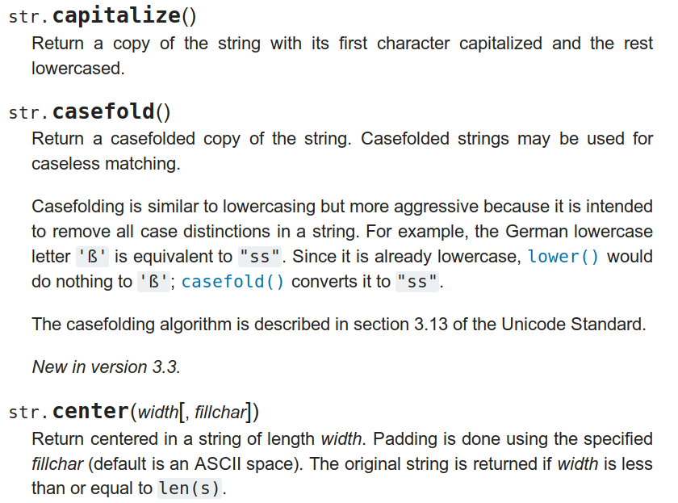
Python’s String Library: Documentation
Look here: https://docs.python.org/3/library/stdtypes.html#string-methods
Insert competency code
Notes:
Screenshot of this website. Python is open source: https://docs.python.org/3/license.html#history-and-license. I assume its documentation is also.
1

Slide 22
Example String Functions
str.capitalize()
str.center(width[, fillchar])
str.endswith(suffix[, start[, end]])
str.find(sub[, start[, end]])
str.lstrip([chars])
str.replace(old, new[, count])
str.lower()
str.rstrip([chars])
str.strip([chars])
str.upper()
Insert competency code
Notes:
1

Slide 23
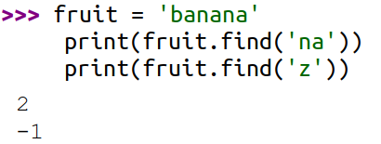
Searching a String
We use the find() function to search for a substring within another string
find() finds the first occurrence of the substring
If the substring is not found, find() returns -1
Remember that string position starts at zero
Insert competency code
Notes:
Text
1

Slide 24
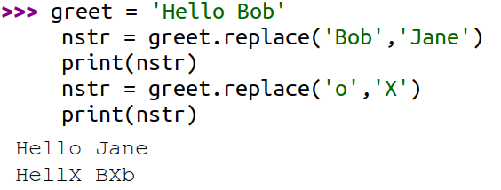
Search and Replace
The replace() function is like a “search and replace” operation in a word processor
It replaces all occurrences of the search string with the replacement string
Insert competency code
Notes:
Text
<number>

Slide 25
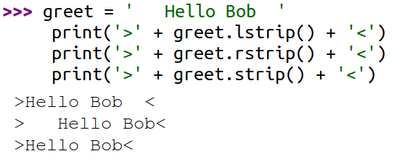
Stripping Whitespace
Sometimes we want to take a string and remove whitespace at the beginning and/or end
lstrip() and rstrip() to the left and right only
strip() Removes both begin and ending whitespace
Insert competency code
Notes:
Text
<number>

Slide 26
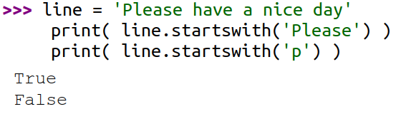
String Prefixes
Functions: startswith() and endswith()
Insert competency code
Notes:
Text
<number>

